Slide 1

MUSIC STORE ANALYSIS USING MYSQL

Slide 2

ABOUT ME
Hello, my name is riya sengar and
in this project i have utilised sql query to solve questions that are related to music store.

Slide 3
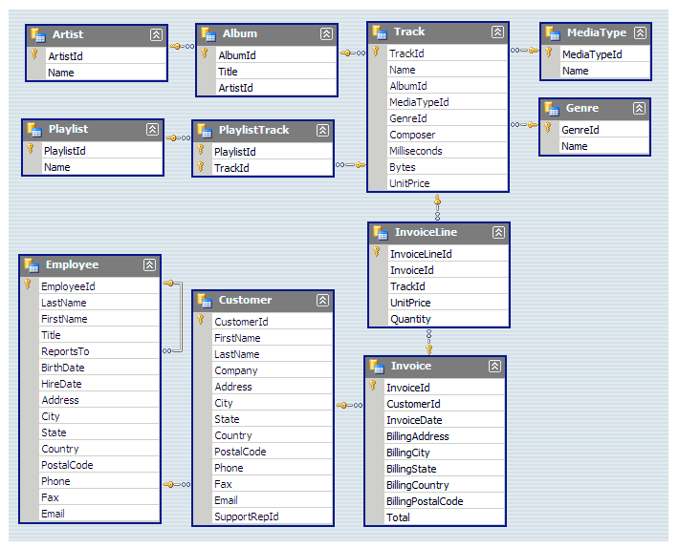
SCHEMA

Slide 4
QUESTIONS
1.Who is the senior most employee based on job title.
2. Which counties have the most Invoices.
3. Return all the track names that have a song length longer than the average song length.
Return the Name and Milliseconds for each track. Order by the song length with the longest songs listed first.
4. Which city has the best customers? We would like to throw a promotional Music Festival in the city we made the most money. Write a query that returns one city that has the highest sum of invoice totals. Return both the city name & sum of all invoice totals.
5. Who is the best customer? The customer who has spent the most money will be declared the best customer. Write a query that returns the person who has spent the most money.
6.Write query to return the email, first name, last name, & Genre of all Rock Music listeners. Return your list ordered alphabetically by email starting with A.
7. Let's invite the artists who have written the most rock music in our dataset. Write a query that returns the Artist name and total track count of the top 10 rock bands.
8. Write a query that determines the customer that has spent the most on music for each country. Write a query that returns the country along with the top customer and how much they spent.
For countries where the top amount spent is shared, provide all customers who spent this amount.

Slide 5

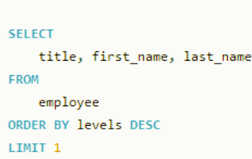
Who is the senior most employee based on job title.

Slide 6

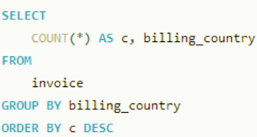
Which counties have the most Invoices.

Slide 7

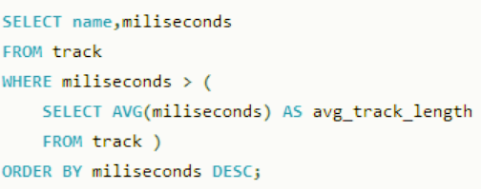
Return all the track names that have a song length longer than the average song length. Return the Name and Milliseconds for each track. Order by the song length with the longest songs listed first.

Slide 8
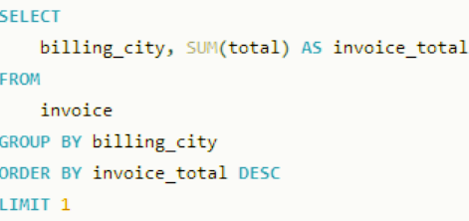
Which city has the best customers? We would like tothrow a promotional Music Festival in the city we made the most money. Write a query that returns one city that has the highest sum of invoice totals. Return both the city name & sum of all invoice totals.

Slide 9
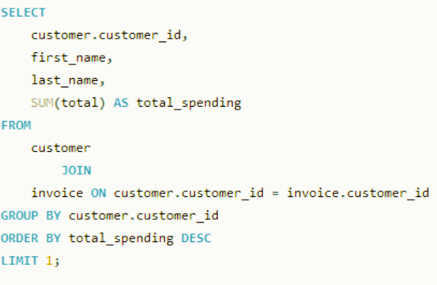
Who is the best customer? The customer who has spent the most money will be declared the best customer. Write a query that returns the person who has spent the most money.

Slide 10
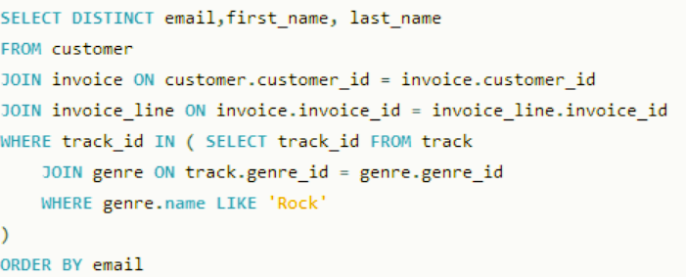
Write query to return the email, first name, last name, & Genre of all Rock Music listeners. Return your list ordered alphabetically by email starting with A.

Slide 11
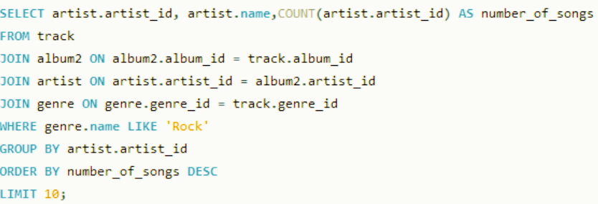
Let's invite the artists who have written the most rock music in our dataset. Write a query that returns the Artist name and total track count of the top 10 rock bands.

Slide 12
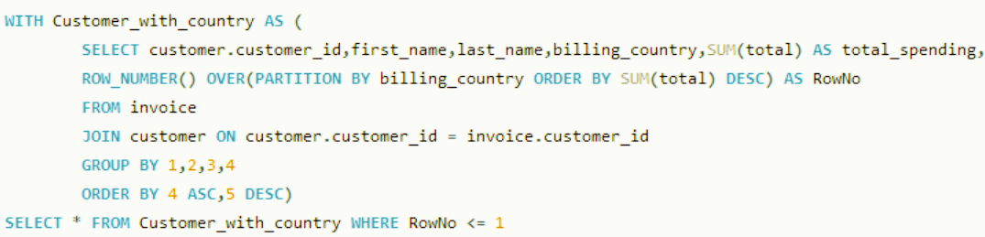
Write a query that determines the customer that has spent the most on music for each country. Write a query that returns the country along with the top customer and how much they spent. For countries where the top amount spent is shared, provide all customers who spent this amount.

Slide 13
THANK
YOU

